Slide 1



MD MOINUDDIN
Capstone Project
Mobile Price Range Prediction
By
MD MOINUDDIN
Data set link which I used : (https://drive.google.com/file/d/1i8bO3xv3x8SzXSeSkDl-2qYjCyc9vxA2/view)
My Portfolio : (http://armanjames.pythonanywhere.com/)

Slide 2
Problem statement
MD MOINUDDIN
As the demand for smartphones increases, consumers face the challenge of selecting the best smartphone that meets their requirements and budget. With the constantly changing market and new technologies being introduced, it becomes difficult for consumers to keep up with the price ranges of smartphones. This is where Mobile Price Range Prediction comes into play. The problem is to predict the price range of a smartphone based on its features, specifications, and brand. With accurate predictions, consumers can make informed decisions and purchase the best smartphone within their budget.
In the competitive mobile phone market companies wantto understand sales data of mobile phones and factors which drive the prices.
The objective is to find out some relation between features of a mobile phone(eg:- RAM,Internal Memory, etc) and its selling price. In this problem, we do not have to predict theactual price but a price range indicating how high the price is.

Slide 3
Points to discuss
MD MOINUDDIN
Data description and summary
Exploratory data analysis
Heat map
Machine learning algorithms
Logistic regression
Decision tree
Random forest classifier
Xgboost classifier
conclusion

Slide 4
Data description
MD MOINUDDIN
The data contains information regarding mobile phone features, specifications etc and their price range. The various features and information can be used to predict the price range of a mobile phone.
Battery_power - Total energy a battery can store in one time measured in mAh
Blue - Has bluetooth or not
Clock_speed - speed at which microprocessor executes instructions
Dual_sim - Has dual sim support or not
Fc - Front Camera mega pixels
Four_g - Has 4G or not
Int_memory - Internal Memory in Gigabytes
M_dep - Mobile Depth in cm
Mobile_wt - Weight of mobile phone

Slide 5
Data description(cont,.)
MD MOINUDDIN
N_cores - Number of cores of processor
Pc - Primary Camera mega pixels
Px_height - Pixel Resolution Height
Px_width - Pixel Resolution Width
Ram - Random Access Memory in Mega Bytes
Sc_h - Screen Height of mobile in cm
Sc_w - Screen Width of mobile in cm
Talk_time - longest time that a single battery charge will last when you are
Three_g - Has 3G or not
Touch_screen - Has touch screen or not
Wifi - Has wifi or not
Price_range - This is the target variable with value of 0(low cost), 1(medium cost),
2(high cost) and 3(very high cost).

Slide 6
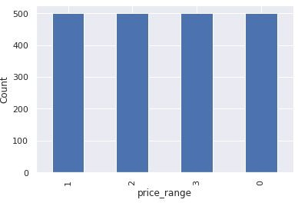
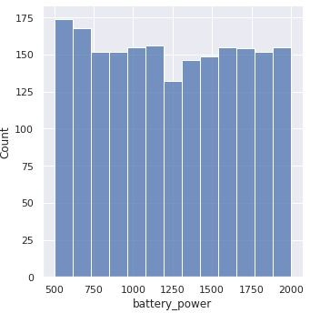
MD MOINUDDIN
Price
Battery
this plot shows how the battery mAh is spread. there is a gradual increase as the price range increases
there are mobile phones in 4 price ranges. the number of elements is almost similar

Slide 7
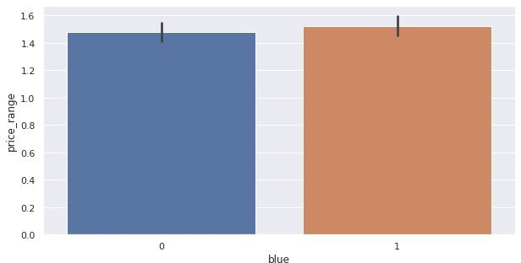
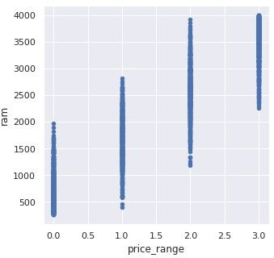
MD MOINUDDIN
bluetooth
Ram
Half the devices have Bluetooth, and half don’t
Ram has continuous increase with price range while moving from Low cost to Very high cost

Slide 8
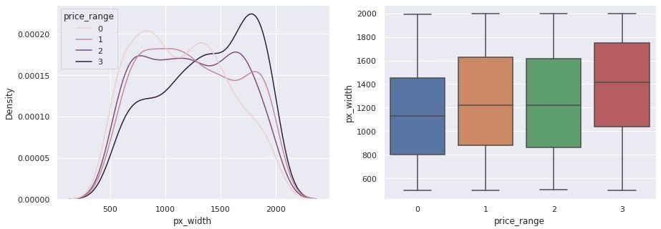
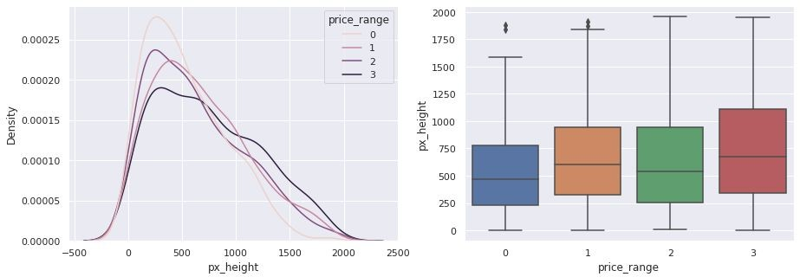
MD MOINUDDIN
Px_width
px_height
There is not a continuous increase in pixel width as we move from Low cost to Very high cost. Mobiles with 'Medium cost' and 'High cost' has almost equal pixel width. so we can say that it would be a driving factor in deciding price_range.
Pixel height is almost similar as we move from Low cost to Very high cost.little variation in pixel_height

Slide 9
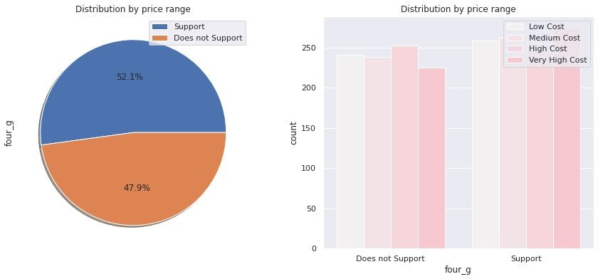
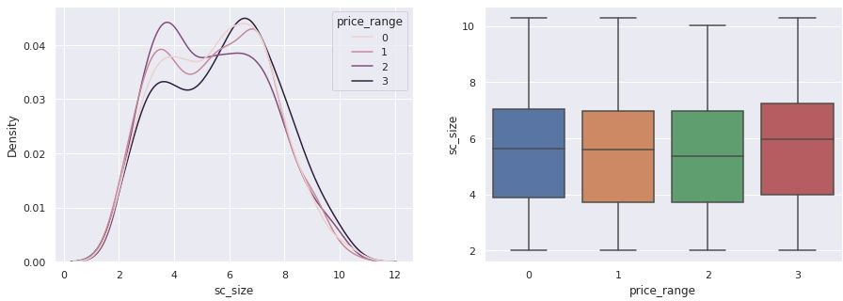
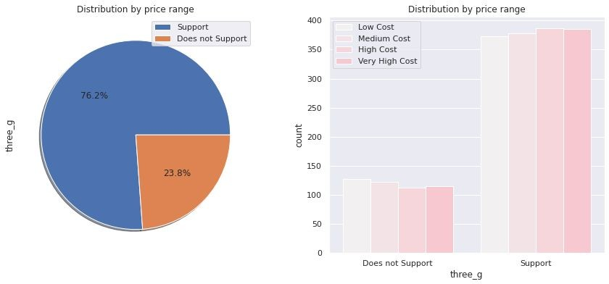
MD MOINUDDIN
4g and 3g
screen_size
Combining the sc_height and sc_width into one column that is sc_size, Screen Size shows little variation along the target variables. This can be helpful in predicting the target categories.
50% of the phones support 4_g and 76% of phones support 3_g,feature 'three_g' play an important feature in prediction

Slide 10
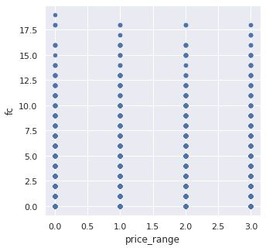
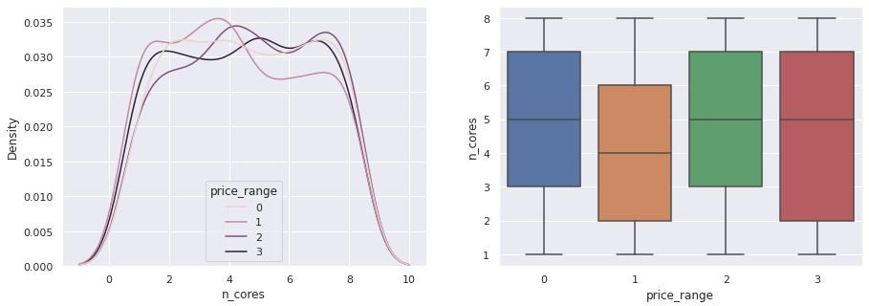
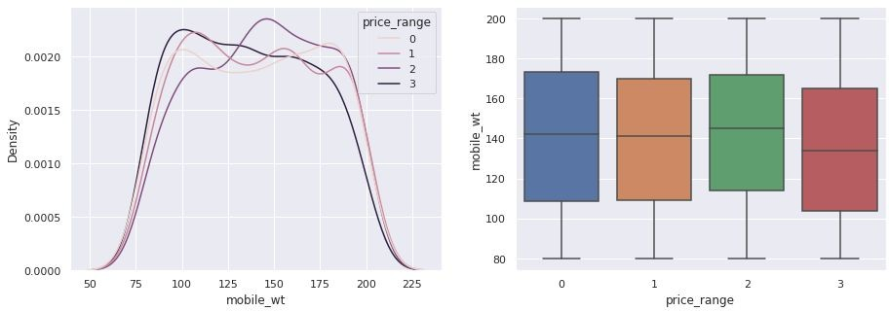
MD MOINUDDIN
FC (front camera megapixels)
PC (Primary camera Megapixels )
mobile weight
This features distribution is almost similar along all the price ranges variable, it may not be helpful in making predictions
Primary camera megapixels are showing a little variation along the target categories, which is a good sign for prediction.
costly phones are lighter

Slide 11
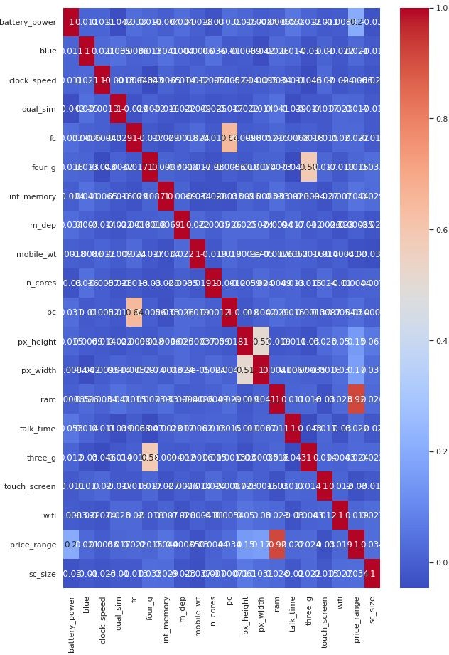
Heat map
MD MOINUDDIN
RAM and price_range shows high correlation which is a good sign, it signiﬁes that RAM will play major deciding factor in estimating the price range.
There is some collinearity in feature pairs ('pc', 'fc') and ('px_width', 'px_height'). Both correlations are justiﬁed since there are good chances that if front camera of a phone is good, the back camera would also be good.
Also, if px_height increases, pixel width also increases, that means the overall pixels in the screen. We can replace these two features with one feature. Front Camera megapixels and Primary camera megapixels are different entities despite of showing colinearity. So we'll be keeping them as they are.

Slide 12
ML algorithms
MD MOINUDDIN
Logistic regression
Decision tree
Random Forest classification
XGboost

Slide 13
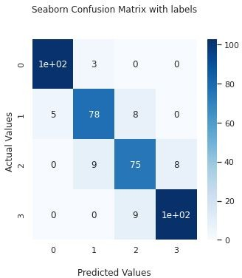
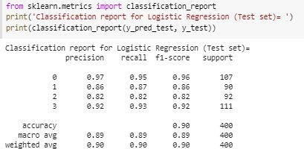
Logistic regression
MD MOINUDDIN
Train_accuracy : 92%
Test_accuracy: 90%

Slide 14
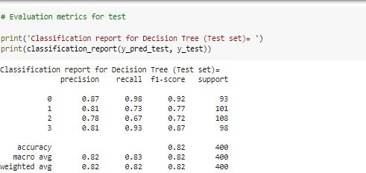
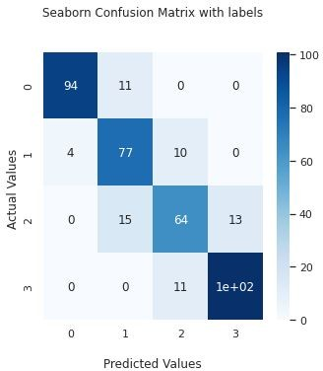
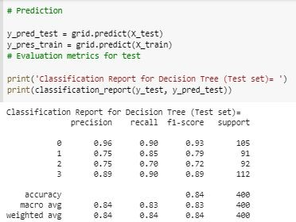
Decision tree
MD MOINUDDIN
Decision tree with hyperparameter tuning
Test_accuracy: 82%
Test_accuracy: 84%

Slide 15
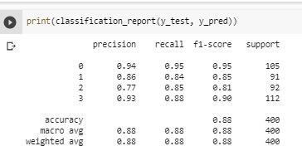
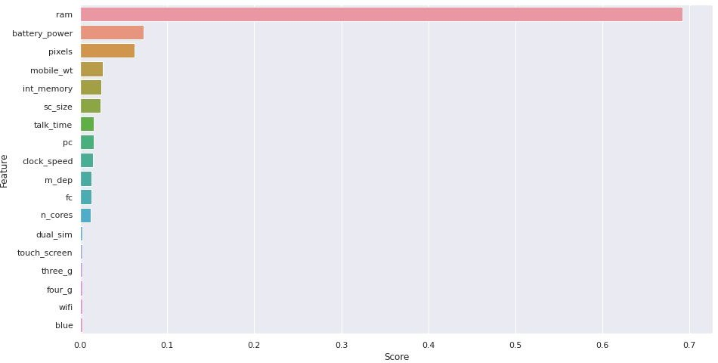

Random forest classiﬁer with hyper parameter tuning
MD MOINUDDIN
Test_accuracy: 88%
As we can see the top 3 important features of our dataset are: RAM, battery_power ,pixels

Slide 16
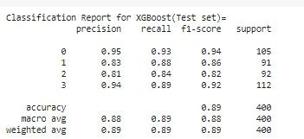
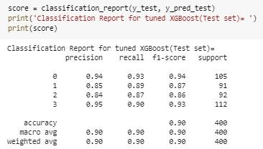
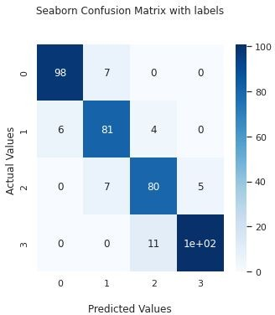
XGboost
MD MOINUDDIN
XGboost with hyperparameter tuning
Test_accuracy: 90%
Test_accuracy: 89%

Slide 17
Conclusion’s
MD MOINUDDIN
From EDA we can see that here are mobile phones in 4 price ranges. The number of elements is almost similar.
half the devices have Bluetooth, and half don’t
there is a gradual increase in battery as the price range increases
Ram has continuous increase with price range while moving from Low cost to Very high cost
costly phones are lighter
RAM, battery power, pixels played more significant role in deciding the price range of mobile phone.
form all the above experiments we can conclude that logistic regression and, XGboosting with using hyperparameters we got the best results
The accuracy and performance of the model is evaluated by using confusion matrix

Slide 18

MD MOINUDDIN

